Slide 1

A Compton Imaging Detector Integrated With a Robotic System
as a Radiation Survey Tool
Final Presentation
Aaron Belman-Wells, Caleb Bush, and Giuliano Fonte Basso
Mentors: James Berry and Dr. He

Slide 2
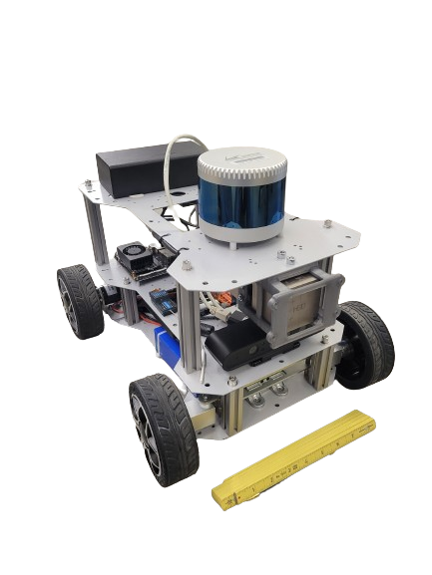
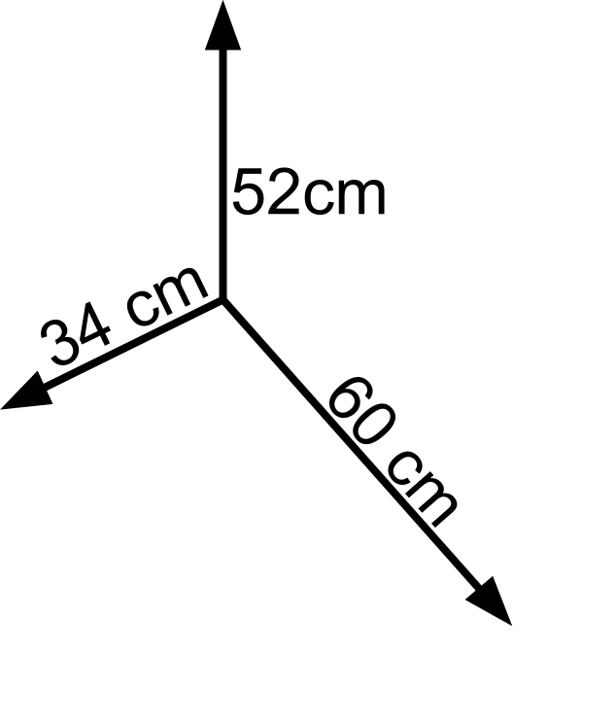

Overview: Equipment and Resources
LiDAR
Using a 3D position sensitive detector to create a robotic survey system
Robotic system
LiDAR, IMUs, and odometers for measuring movement
Jetson TX1 for computation
H3D M400 Detector
Pixelated CZT detector determines where an interaction took place and how much energy it released
Uses Compton imaging to determine the relative position of a radioactive source in 3D
Jetson TX1
M400
Detector
Notes:
G: Hi everyone, we are [] and we will be presenting on a robotic system that uses a compton imager to map gamma sources in 3 dimensions. This work is the continuation of a prior senior design team’s work, and it relies on two major systems. System one is the robot itself, which uses LiDAR and Odometry (point at picture) to track it’s position, as well as carrying the computer that processes data and allows us to control the robot remotely. The second is the incredible H3D M400 (make a friendly wave at Dr. He), which is a pixelated detector that can track compton scatters within itself to guess the angle a gamma ray came from. We are going to explain both of these subsystems in detail in a moment, but first, a little background on why this was created in the first place.

Slide 3
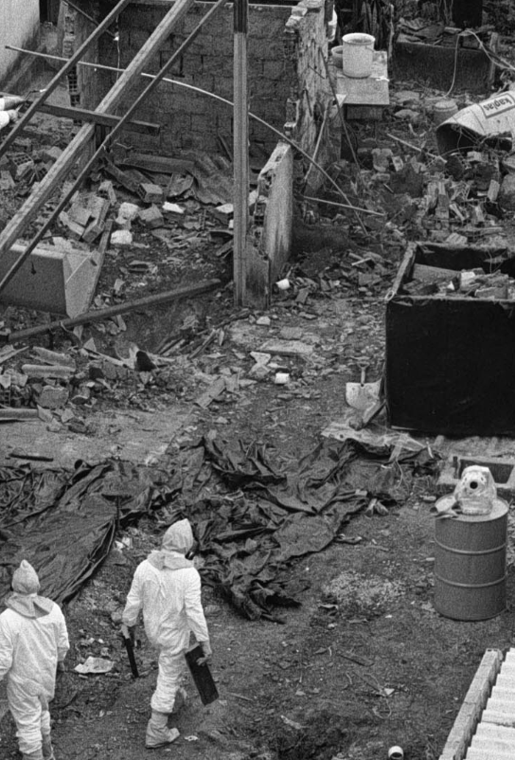
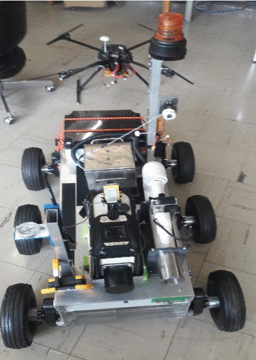
Background: Use case
Goiania Brazil:
kCi ¹³⁷Cs source is lost from a hospital
4 dead, 28 badly injured, over 3500 cubic meters of radioactive waste generated
Difficulty finding the source because of the danger to workers
Prior work:
Robots capable of detecting radiation intensity
Requires human interpretation to locate source ^{[1]}
Alternative radiation survey robot
Radiation Workers in Goiana ^{[2]}
Vázquez-Cervantes et. all, 2017
Notes:
G: So we certainly aren’t the first people to think of putting a detector on a robotic system, or even close. The appeal is obvious, robots are great! They don’t get tired of carrying around heavy equipment, they don’t forget measurements, they can process lots of data, and perhaps most importantly, we don’t have to worry about their absorbed dose. So, one of the cases we have been using as an example is the lost source in Goiania Brazil, where a kilo-Curie Cobalt source from a hospital was lost and a lot of people got hurt, and radiation workers had serious trouble finding the lost source because they couldn’t safely look for it in the junkyard where it ended up, and some of the source even was left behind. This is a great use case for a system like the one we have been working on. And we aren't the first people to think so, in fact [list some other cases]

Slide 4
Prior Team’s Work
Bought robot and integrated M400 to create radiation mapping system
Gaussian imaging was found to not be accurate or reliable
Compton imaging could be very accurate, average of 21 cm difference, but surveys and data processing take impractically long
Spectroscopy successfully identified isotopes in 99.6% of 3002 spectra
Used ideal data with lead shielding to block much of background
High accuracy, but all data must be collected before being processed (~ minutes)
Notes:
A: So like G said, we aren’t the first people to try this, it’s actually a pretty popular idea. Which lead to our preceding senior design team designing this system, specifically for use as a survey tool. Their system had [explain accuracies]. However, all of their data needed to be collected with no feedback, and then post processed later to see images and locations.

Slide 5
Motivation: Continuing work
Need for live data collection and processing
Both teams motivated by taking the human operator out of danger
We still want the human operator to be able to make intelligent decisions based on collected data
Real world survey tool: data must be collected and processed live and wirelessly, without compromising accuracy
By delivering 3D information to an operator in real time, the speed and accuracy of surveys is increased, making the system practical for remote operation in real-world conditions, keeping future operators out of harm's way.
Notes:
A: So, as we have been establishing for a while now, the main advantage of a robotic survey system is that it 1.) Keeps a human operator out of harm's way, and 2.) keeps a human operator IN the information loop, making intelligent decisions. We’ve shown you how accurate the existing system can be, but we also told you it relied on post processing the data. This is a great tool for making maps of radiation if you know where a source is. On the other hand, in a survey or lost source situation, an operator will be able to collect data much faster if they can drive the robot bases on the data they are collecting live. This is where we come in, our work centered around rebuilding this system in a way an operator can sit in another room and drive the robot based on the data they collect, without taking away from the impressive accuracy we know the M400 is capable of.

Slide 6
Design Requirements
Must match speed and accuracy of existing systems in live processing
Precise Localization:
Able to locate a weak (60 μCi) ¹³⁷Cs source to within 15 cm
Accurate Spectroscopy:
Able to identify gamma emitters with 95% accuracy
Fast Operation:
Time from final data collection to complete report must not exceed 60 s
All data must be processed at least as fast as it comes in
Notes:
A: Which is exactly how we created our design requirements. For localization, you can see we wanted to be able to locate a weak source to within 15 cm, because that is close to the lowest error the prior group achieved. Our spectroscopy was required to be 95% accurate or better for the same reason. Finally, we know that on it’s own the M400 is quoted as being able to find very weak check sources like the ones we had access to in under a minute, so our goal was to achieve comparable speed for the whole system. To put it in a sentence, we need to integrate all of the existing systems and process their data, without taking away from the speed and accuracy that are the whole reason we have this very high fidelity detector.

Slide 7
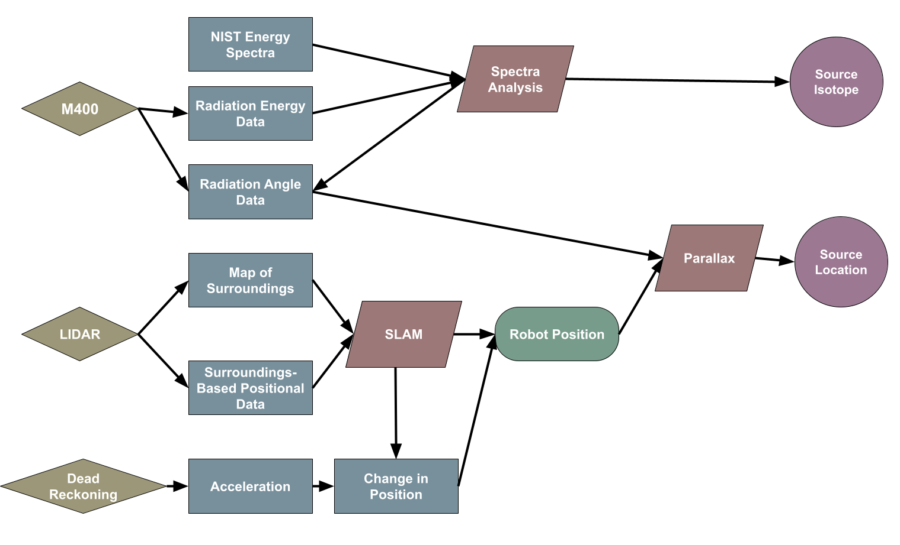
Flow of Information
Collected on Robot
Processed remotely by Python
Notes:
Notes, not script:
Deliver show what parts were live vs active
(tell what we aree hsowign what parts were not live, how we were able to show what was live)
We will show what 3 processes we will walk through:

Slide 8
Flow of Information
NIST Energy Spectra
Source Isotope
Spectra Analysis
Radiation Energy Data
M400
Radiation Angle Data
Source Location
Parallax
Map of Surroundings
LIDAR
SLAM
Robot Position
Surroundings- Based Positional Data
Dead Reckoning
Acceleration
Change in Position
Notes:
To start with, we need to explain the M400 and how it produces angular data.

Slide 9
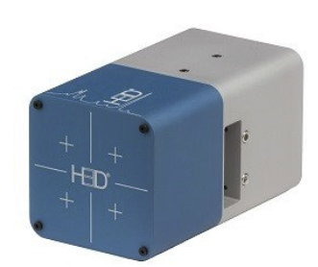
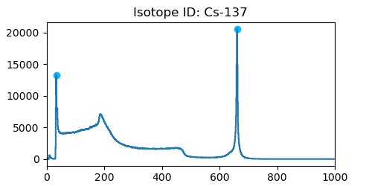
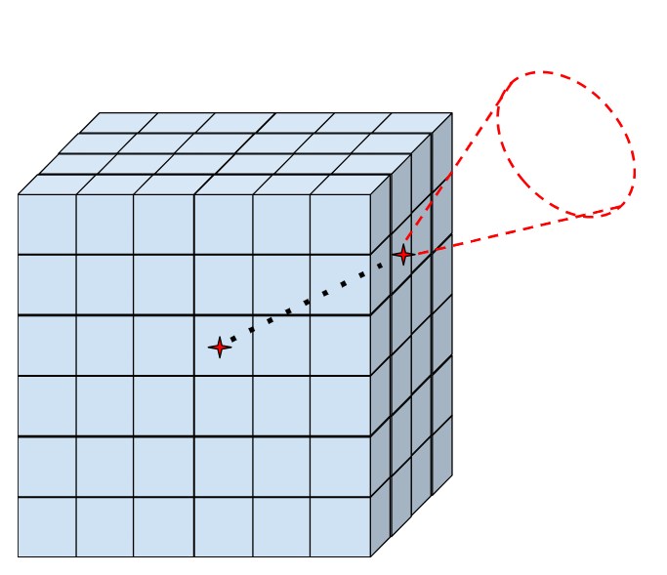
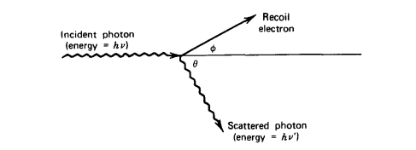
Fundamental Equipment: M400 Compton Camera
Materials
M400 position sensitive Cadmium Zinc Telluride (CZT) gamma-ray imager
A 19 cm³ pixelated detector which can see individual Compton scatters
Energy resolution of < 1% FWHM for ¹³⁷Cs
Pre-existing software to provide source “heatmap” but also publishes raw data wirelessly
Problem: existing software is difficult to access/ modify, and produced data is hard to access wirelessly / slow to process live
Sample ¹³⁷Cs spectra
^{[3]}
H3D M400
Compton Scatter
^{[4]}
H3D M400 internal interaction
Notes:
C: Yes, the M400, so important that it gets its own slide. The M400 is a CZT semiconductor detector, which is divided into small pixels, which for the purposes of this you can just assume it’s a lot of small detectors. It has an incredible energy resolution, less than 1% for Cs-137. When a compton scatter occurs within the M400, 2 of the “mini-detectors” see it at the same time and record the energy at each…

Slide 10
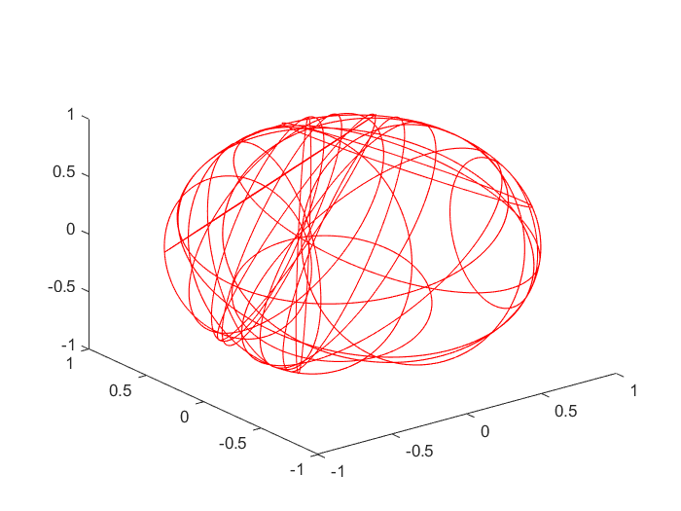
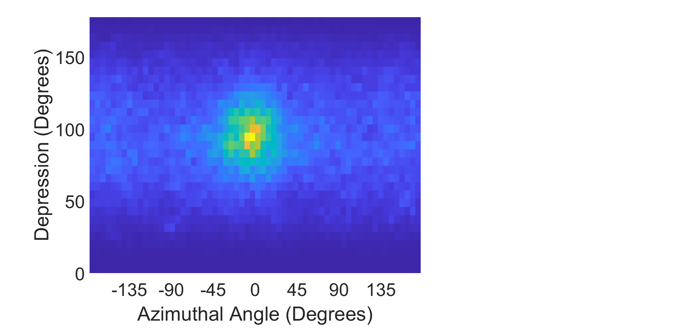
Compton Imaging
Methods
Using M400 gamma-ray imager, backproject Compton-scatters to find the likely position of gamma sources
Solution: create our own Python code to process raw data
Uses “weighted back-projection” to quickly determine guesses of source angular position
Makes several “best guesses” to improve operating speed
H3D M400 Internal Interaction
H3D M400 Internal Interaction
Robot ‘vision’ heatmap

Slide 11
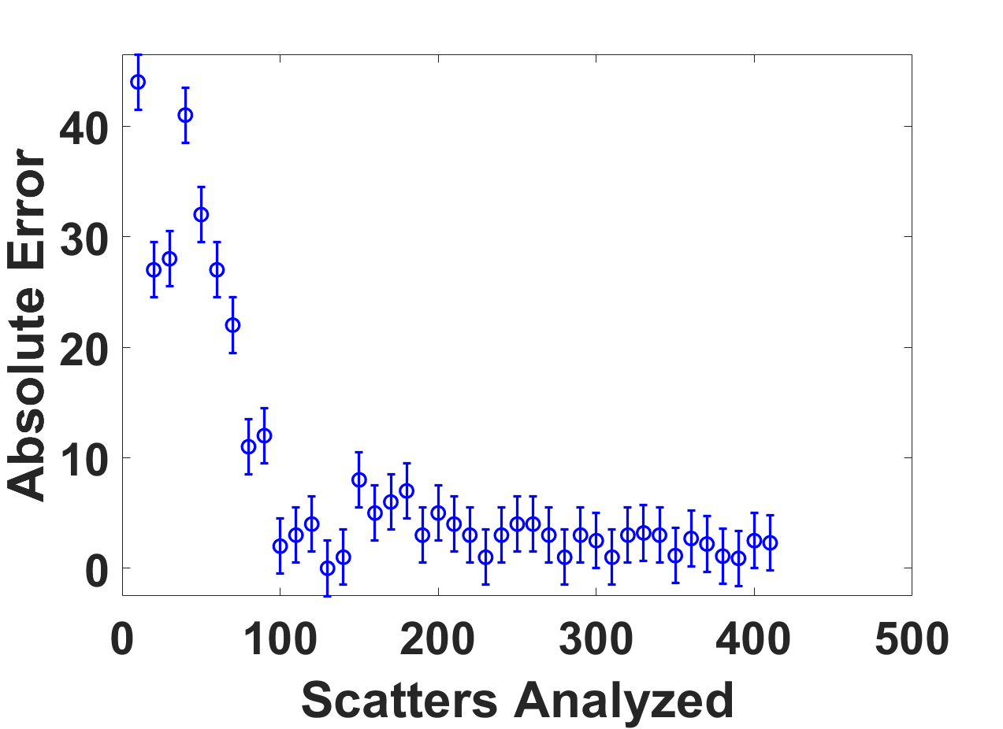
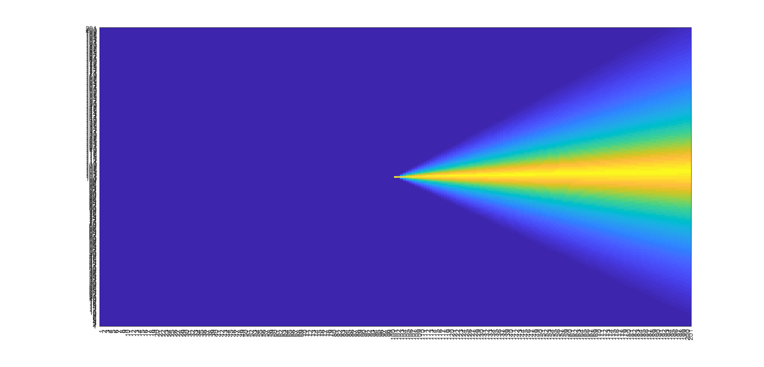
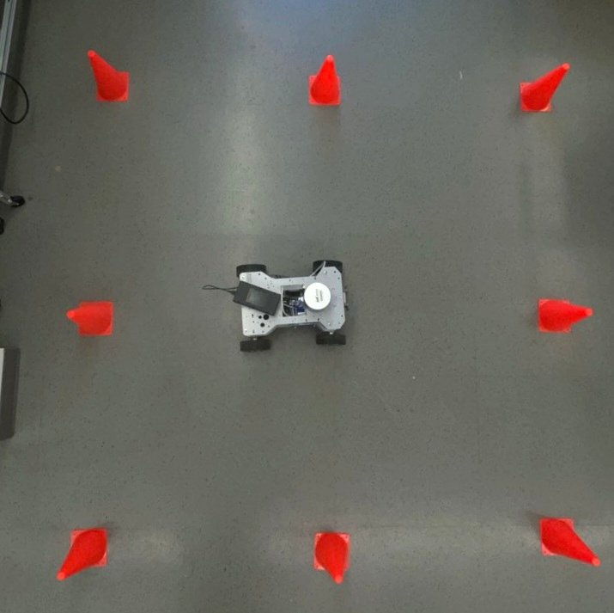
Compton Imaging
Results
Developed program is over 95% successful at producing position estimates to within 5 degrees when given 200+ Compton scatters
200 usable Compton scatters = ~30-45 seconds for our 63 uCi source at 1m
H3D quotes time to find a 10 uCi Cs-137 source at 1m as <90s
Our source finding program runs in comparable time, however image processing is much slower
Accuracy determined by statistical factors, more recorded scatters gives either more guesses or better guesses
Data collection on the order of minutes or less, data processing in under 20 seconds
Error as more Scatters are Analyzed
Source Finding in Action

Slide 12
Flow of Information
NIST Energy Spectra
Source Isotope
Spectra Analysis
Radiation Energy Data
M400
Radiation Angle Data
Source Location
Parallax
Map of Surroundings
LIDAR
SLAM
Robot Position
Surroundings- Based Positional Data
Dead Reckoning
Acceleration
Change in Position

Slide 13
Spectral Analysis
Methods
Uses NIST Data
Live N42 M400 data is collected ensuring proper decoding of compressed data
Passed through Python integrated Savgol filter to smooth and used a modified findpeaks
Use of available system in Python allows for fast processing
Matching found peaks to NIST data giving weighted values to assess the correct one
M400
Intensity Dependent
N42 Data
Python
2-10
Seconds
NIST Data
Source Isotope/
Graph
Notes:
Introduce m400 key piece of information, Intro(Key anabeling of the system, Post processing, live for us, Glue that enables us)-> 400->
Ground presentation, left slide X, H

Slide 14
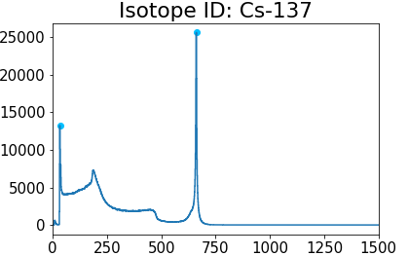
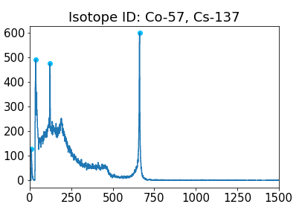
Spectral Validation
Results
Takes seconds to identify “ideal” spectra
Successfully identified 160/160 provided spectra
Limited real world test
Tested ¹³⁷Cs, ⁶⁰Co, ⁵⁷Co
Identifies 11 minute long measurements of ¹³⁷Cs within 2 seconds
Live data produced isotope identification in under 20 seconds in all tests
Counts
Energy (keV)
Counts
Energy (keV)
Example Identified Spectra
Notes:
Approach, did it work. Higher efficiency.

Slide 15
Flow of information
NIST Energy Spectra
Spectra Analysis
Source Isotope
Radiation Energy Data
M400
Radiation Angle Data
Map of Surroundings
Source Location
Parallax
LIDAR
SLAM
Surroundings- Based Positional Data
Robot Position
Dead Reckoning
Acceleration
Change in Position

Slide 16
Resources for Robot Position Finding
IMUs and Odometry
Inertial Measurement Units determine the acceleration in six axis, second integral used to find position
Odometers measure the number of rotations each wheel undergoes and the angle of the front wheels
Both methods experience drift over time or distance
LiDAR
Light Detection And Ranging determines distance to nearest surface in a 270° arc
Stores a map of surfaces and uses new data to simultaneously find its position and update the map
Only accurate to within a few centimeters and unable to determine position without nearby walls
Notes:
A: We had access to two basic methods of position finding: dead reckoning which uses IMUs (inertial measurement units) in 6 axis to determine the acceleration of the robot which can be integrated to get position and odometers which measure the number of times the wheels have turned to the same effect, and LiDAR (Light Detection and Ranging) which can determine the distance to each point in a flat plane for the 270 degrees in front of it. The LiDAR equipment we have isn’t super accurate, and can be thrown off in large empty rooms and the like, but can be used to reset the positions which we get from dead reckoning, which otherwise drift.

Slide 17
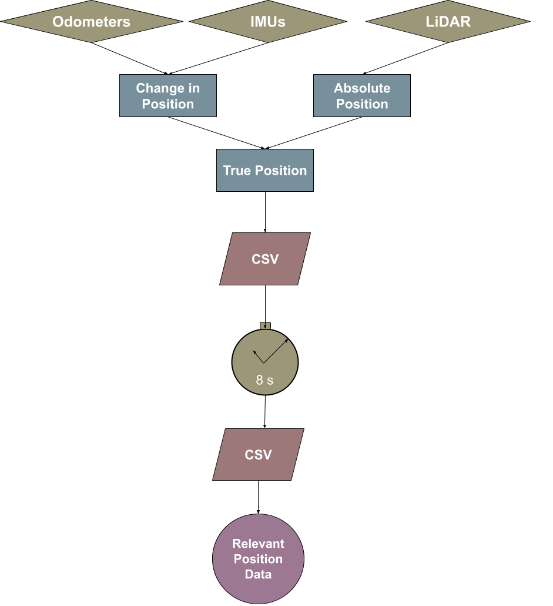
Methods of Robot Position Finding
Both sets of data are collected by ROS
ROS also combines them, using LiDAR to reset odometry and IMU data when possible
Sent to CSV by ROS, then processed in Python to collect relevant information in second CSV
If unchecked, ROS will write to CSV too quickly, rendering Python unable to read from it
To prevent this, ROS takes a break every 8 seconds for Python to move relevant data elsewhere
Notes:
A: Combining the data in this manner is complicated, so thankfully ROS (Robot Operating System) does that for us, first combining odometry and IMUs to get a change in position and then merging that with the LiDAR data. From there, I wrote a function to send the information to a CSV. Unfortunately, ROS gets a lot of data, so it is publishing to that CSV twenty times per second. Since bash can’t open and close a file 40 times per second, it can’t quite be read out ‘live’ - instead I have it stop publishing for a second every eight seconds, then a Python script goes in, collects what information is important, and sends that to a second CSV which can be accessed more readily.

Slide 18
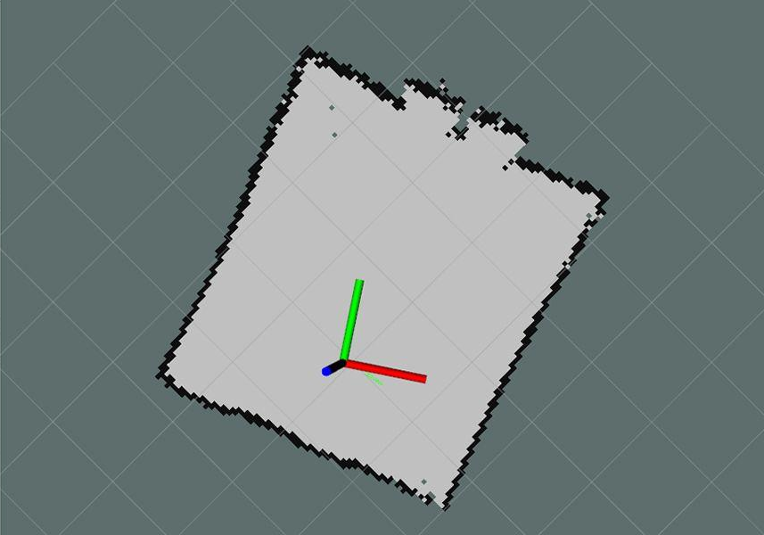
Verification of Robot Position Finding
Position starts off entirely accurate
Drifts by a millimeter / m when moving straight forward at constant speed
Greater drift when making turns or undergoing rapid acceleration
Stabilizes at approximately 10 cm error when LiDAR kicks in
5 meters
Example Lidar Map Output [5]
Notes:
A: What did this get us? Pretty good data. When driving straight forward without much acceleration, the position drifts by about a millimeter per meter travelled, though this increases with sharp turns or high acceleration. After approximately 10 cm of drift, the LiDAR becomes better than the dead reckoning systems and resets it, so for very large rooms your uncertainty in position is capped at approximately 10 cm - assuming you can get good LiDAR data.

Slide 19
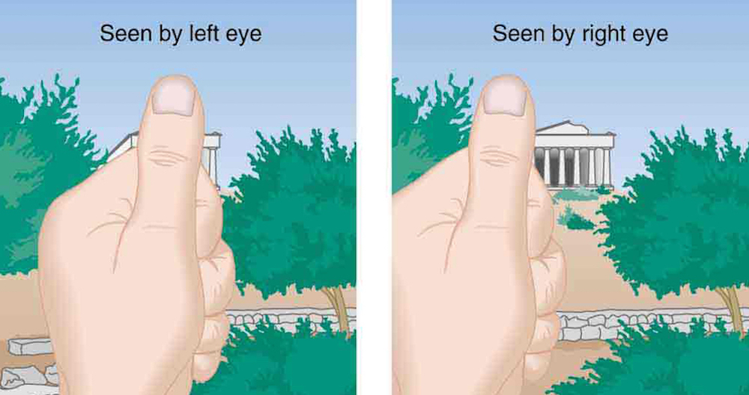
Method of Source Localization
Combine positional and angular data from robot with angular data from detector to create a ray pointing towards the source
Repeat from different positions
Algorithm finds the point that minimizes the mean absolute distance to all rays
Mean squared distance would result in bad data outweighing good data
Example Binocular Range Finding [6]
Notes:
A: Now that we have where the robot is, including which direction it is facing, we can combine that with the direction the source is in, relative to the robot’s front, and create a ray. When you have multiple of these rays with different bases, you can determine where they intersect, which is one of the ways that your brain judges distance. Unfortunately, the rays that our robot gets don’t actually quite intersect - the base and direction being off by a few centimeters and a few degrees respectively makes sure of that. Therefore, we developed an algorithm that seeks to find the point in 3D space that minimizes the total distance between it and each of the rays we have. Out of the two ways to do this, I went with mean absolute distance, exactly what it says on the tin, since mean squared distance would give too much weight to the occasional bad data that we get.

Slide 20
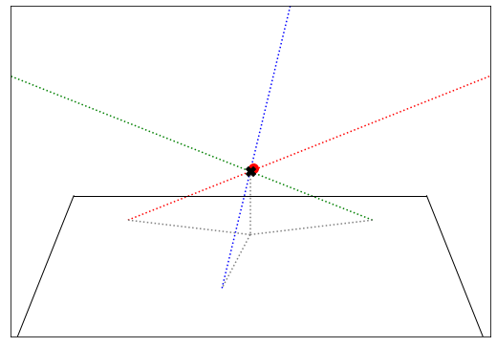
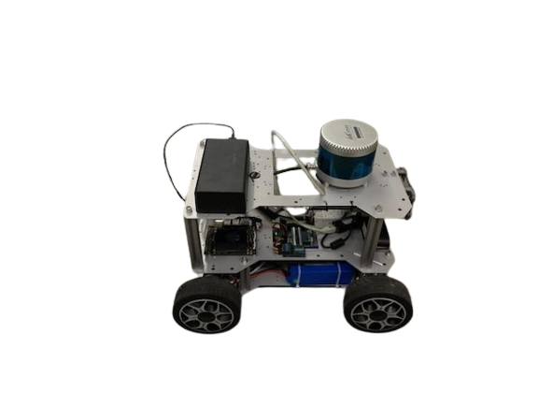
Verification of Robot Capabilities
A 63 µCi source was found with 3.9 cm of error
Experiment took 4 measurements in 5 minutes
Source position was known, so no time was spent looking for the region of the room the source was in.
¹³⁷Cs identified in <5 seconds
1 billion simulated tests run, using 5º angular error and 10 cm positional error
98.3% success rate with average failed distance of 23.2 cm
Mock-up of Full Source Finding Procedure
Notes:
So, after getting all of these modules working together, we ran a couple of tests. In both cases, we placed a 63 µCi Cs-137 source in the lab and then took measurements from the robot in four positions around it for one minute each. After the fourth measurement, when all the data was compiled, the estimated position of the source would be compared to the actual position, measured from the robot’s starting position. This resulted in errors of 8 and 4 cm in the test cases. In addition, the spectroscopy program behaved perfectly, identifying the source as Cs very quickly.

Slide 21
Conclusions
What Has Been Done
Significant increase in speed - data processing takes seconds
Source identification has been improved in real-world conditions
The robot is capable of determining the angle to a source to within 5° 95% of the time
The system as a whole can localize a source to within 15 cm
What Can Be Done
The robot can only track on source at a time
Enabling it to track multiple sources of different radioisotopes should be simple
Enable the robot to track multiple sources of the same isotope simultaneously
Requires new Compton and parallax programs
Test in more real world conditions
Create protocols for operators
Notes:
Gui
Comerticalized
Proportal (detection switching) active or proactive
Design problem
Conceptualization.
Converted the whole system, from code to hardware limitation.

Slide 22
Credit Statement
Caleb Bush: Writing program for detector data retrieval, writing “weighted back projection” Compton scatter algorithm.
Giuliano Fonte Basso: Background research, improving spectroscopy runtime, source identification, and design of visuals for presentation.
Aaron Belman-Wells: Writing software for integrated systems source localization, robot position finding, and validating systems.
James Berry: Significant technical help with the robot and with locating resources.
Dr. He: Access to the robot and the M400 detector, advice on presentation.
Staff of the ORION Lab: Help with programs and access to check sources.
Ners 492 instructional team: Help presenting results.

Slide 23
References
R. M. Vázquez-Cervantes and F. J. Ramirez-Jiménez, "6-Wheel Terrestrial Robot for Radiation Detection," 2017 IEEE Nuclear Science Symposium and Medical Imaging Conference (NSS/MIC), Atlanta, GA, USA, 2017, pp. 1-5, doi: 10.1109/NSSMIC.2017.8532653.
Veja Fotos Da Época Do Acidente Com O Césio-137 Em Goiânia.” G1, g1.globo.com/goias/fotos/2012/09/veja-fotos-da-epoca-do-acidente-com-o-cesio-137-em-goiania.html#F563546. Accessed 18 Apr. 2024.
M400 - H3D, Inc. (2024). h3dgamma.com. https://h3dgamma.com/M400Specs.pdf
Knoll, G. F. (2000). Radiation detection and measurement: Glenn F. Knoll.. United Kingdom: Wiley.
Brini, W. (2022, September 16). How to create a 2D map of your room with LiDAR. MUO. https://www.makeuseof.com/how-to-create-a-2d-map-of-your-room-with-lidar/
Hunt, J. (n.d.). Parallax . Parallax. https://www.joyceproject.com/notes/080008parallax.htm

Slide 24
Generative AI statement
The UM-GPT tool was used to generate and debug some sections of code in both Compton scattering and position finding systems. This was the only use of generative AI in this project, and AI was not used to generate any part, text or image, of this presentation.

Slide 25
Questions

